Slide 1

Infinity API 101
Adam Forester

Slide 2
Who Am I…
Started with a CP Partner in 2001
Became a CP Instructor in 2004 teaching CCSA/CCSE
Moved to a large Healthcare Customer in 2009 Managing 65+ clusters of CP using Provider-1 amongst other security technolgies
Joined CP in Dec 2014 as a Strategic Accounts SE
2017 Code Hub Contribution of the Year Nominee

Slide 3
Agenda
What is an API?
Automation vs Orchestration
The INFINITY API
The Beginners Guide to API
Advanced Shell Scripting
JSON and JQ

Slide 4
What is this “API” you speak of?? And why is it always RESTing?!?

Slide 5
In short…
An API is a means by which to interact with a computer system or software…

Slide 6
Or, as reported by Dr. Google
In computer programming, an application programming interface (API) is a set of routines, protocols, and tools for building software applications. An API expresses a software component in terms of its operations, inputs, outputs, and underlying types.
APIs - Wikipedia
https://en.wikipedia.org/wiki/Application_programming_interface

Slide 7
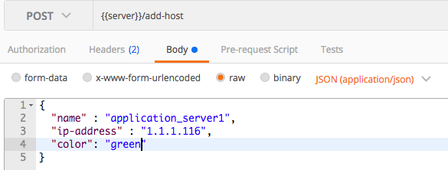

Get some REST!
Representational State Transfer an architectural style and approach to communications often used in web development.
Is the mechanism that allows for systems to access , manipulate , delete , change , add resources on an application via web services.
Rest APIs are called via standard URLs , for example:
https://r80-mgmt/web_api/add_host
The application exposes HTML calls such as : get/post/put/delete , etc.
The data being exchanged can be in formats such as:
HTML , JSON , XML.
R80 SmartCenter/MDM
https://r80mgmt/web_api/add_host

Slide 8
Automation
Vs
Orchestration

Slide 9
Automation
is concerned with a single task – launching a web server, configuring a web server, stopping a service, etc., in a repeatable, consistent manner. Automation is about laying a building block of consistent, predictable content.

Slide 10
Orchestration
is concerned with automating the execution of a workflow – of a process. Orchestration is the choreography of a series of (automated) tasks – putting the tasks together into a logical series (workflow).

Slide 11
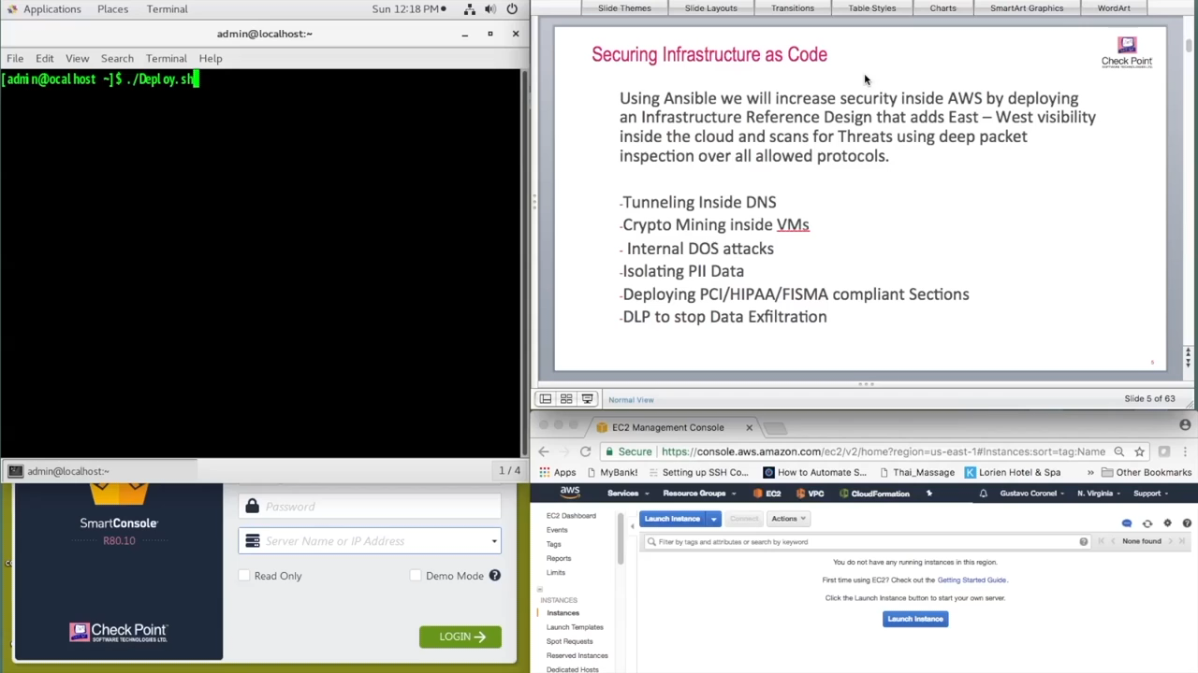

Slide 12
Check Point Automation Solutions

Slide 13
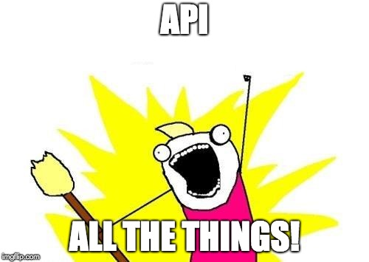
Infinity APIs
80.10 API
GAIA API
Identity Awareness API
Threat API
Generic API
sk121360

Slide 14

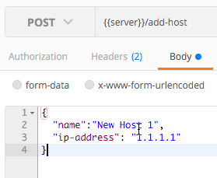
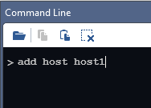
Flexible and Powerful Automation – R80
Web Services API
Mgmt CLI
SmartConsole Command Line
[Expert@r80mgmt:0]# mgmt_cli login
Rest APIs / JSON format
Shell Scripting
Faster Operations
API Guide : https://sc1.checkpoint.com/documents/latest/APIs/index.html

Slide 15
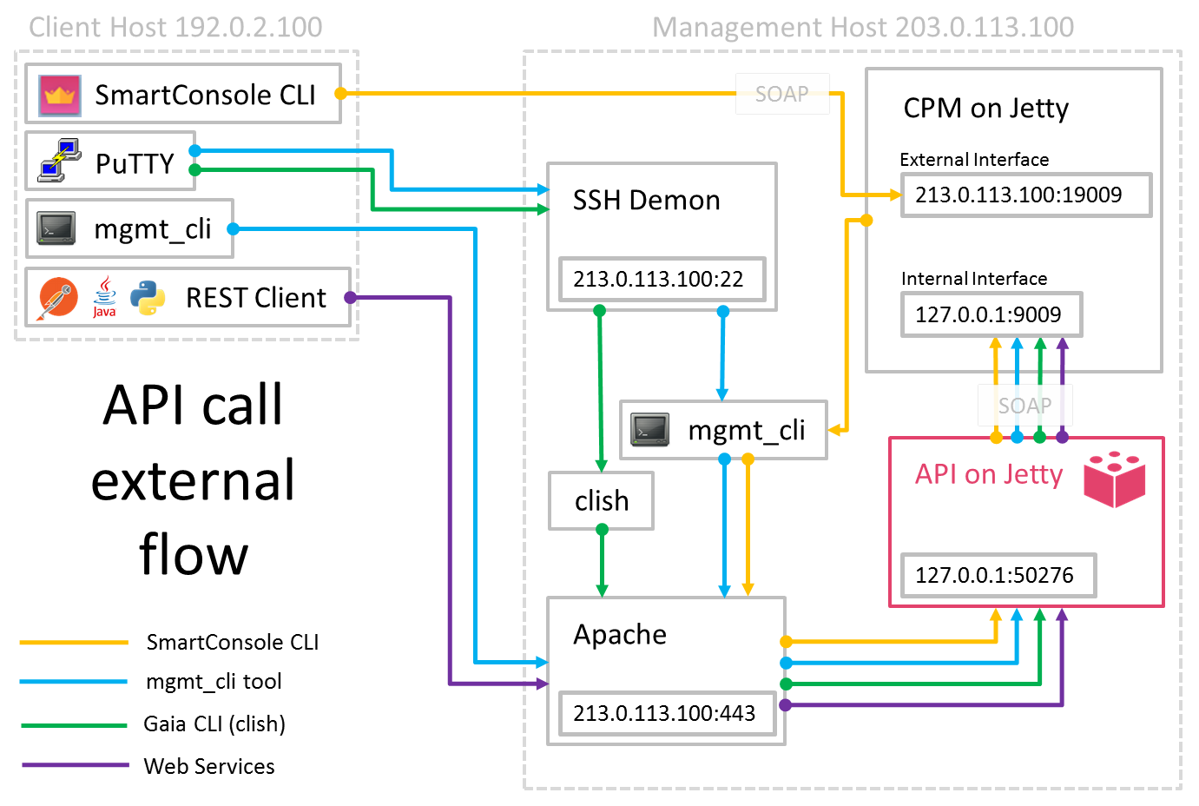
R80 Architecture

Slide 16
What would I use this for??

Slide 17


Slide 18
Use Cases
Adding massive amounts of objects
Modifying Objects
Automated Deployment of Gateways
Auto-remediation (SmartEvent)
Base Policy build
Cleanup
Really…. Everything…

Slide 19
But first… Have you tried turning it on??

Slide 20
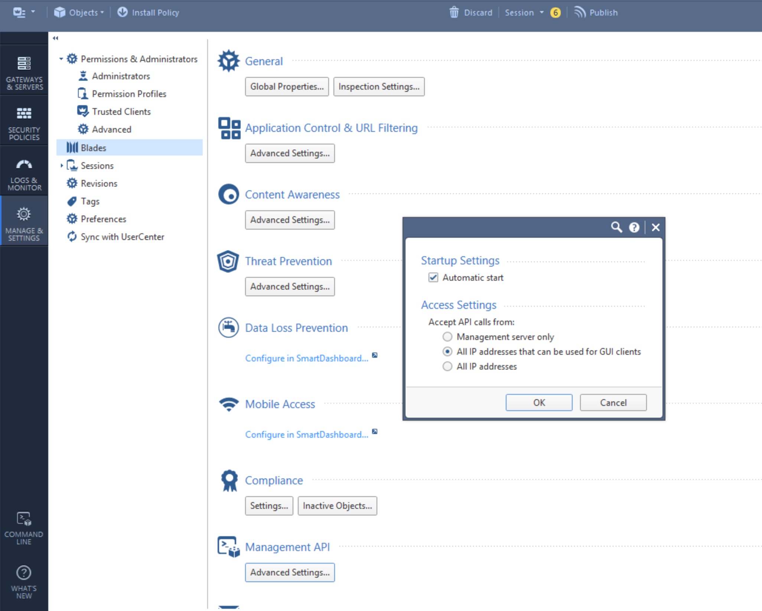
Enabled by default
Unless you have less than 8gb of RAM

Slide 21

API (command line)

Slide 22

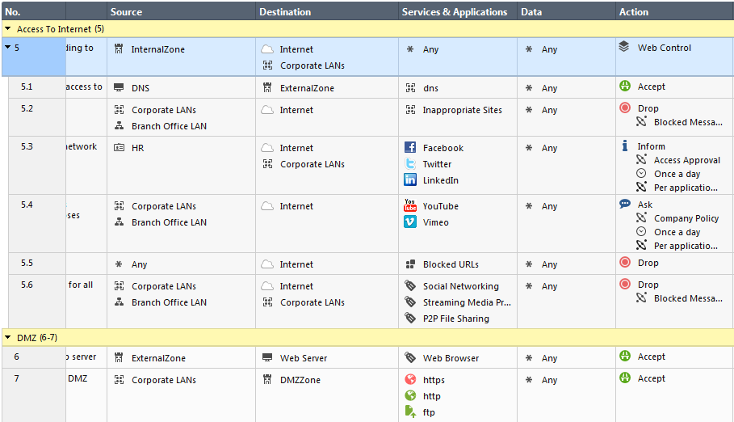

Delegation with Inline Layer
John still has full admin privilege on Parent Rule
Subpolicies or inline layers are ideal for delegation.
Delegate subpolicy to API User
Notes:
sub-policy
1) Performace
2) Like sections but with enforcement
3) delegation (currently lacking becuase the delegated anmin can change all objects). If we delegate the parent rule, we miss the point of delegation because we give the admin full power...
4) zone based policy++
5) sharing.
Note: In Profile permission the Common Objects are currently by default set to Read for custom profiles The R/W permission is for all objects and NOT per layer or a container of objects. In Future a solution will be provided to delegate Write permission to a set of objects.

Slide 23
The Beginners Guide to API
(mgmt_cli)

Slide 24
Follow the Guide!!!

Slide 25
MGMT_CLI
Built into 80.X can be used to execute commands from expert mode
Installed by default as part of SmartConsole
Can be installed on any Windows Machine
It is mandatory to provide login credentials or use a session-id token that was obtained previously using the ‘login’ command

Slide 26
Stay in the flow…
Login
Send Rest Action
Publish
Logout
https://<mgmt>/web_api/login
https://<mgmt>/web_api/add-host
https://<mgmt>/web_api/publish
https://<mgmt>/web_api/logout
Install Policy
https://<mgmt>/web_api/install_policy

Slide 27
LOGIN - Passing Credentials
# mgmt_cli add host name minion2 ip-address 2.2.2.2
Username: api_user
Password:
# mgmt_cli add host name minion3 ip-address 3.3.3.3 –u RandomTask
Password:
# mgmt_cli add host name minion4 ip-address 4.4.4.4 –u RandomTask –p coffee
When not using a defined session, “Login” and “Publish” happen implicitly
Mgmt_cli –r true

Slide 28
Login - Session-ID
In the GUI, you start with a login dialog and everything that you do is later associated with your “session”.
mgmt_cli login user api_user password vpn123
sid: "n6WWLtG_5fErplyLuRA50sgVZy8qjeuh01tf5NeEmKg“ url: "https://127.0.0.1:443/web_api" uid: "82e6a475-435b-4761-a572-74b19128a776“ session-timeout: 600

Slide 29
Login - Session-ID – cont’
Export session-id to a file
Mgmt_cli login > id.txt
Can be called later using the -s switch
Mgmt_cli command -s id.txt

Slide 30
Send REST Action - Example Command
Simply create a new host
mgmt_cli add host name minion1 ip-address 1.1.1.1
mgmt_cli add host name minion1 ip-address 1.1.1.1
mgmt_cli add host name minion1 ip-address 11.11.11.11
Command
Key value
(always come in pairs)

Slide 31
Let’s Automate a task…
Login and create a new host
mgmt_cli login user api_user password vpn123 > id.txt
mgmt_cli add host name minion1 ip-address 11.11.11.11 –s id.txt
mgmt_cli publish –s id.txt
mgmt_cli logout –s id.txt
Notes:
mgmt_cli -r true show objects type "host" --format json | jq '.objects[] | (.name + " " + ."ipv4-address")'

Slide 32
The components: Command
Login and create a new host
mgmt_cli login user api_user password vpn123 > id.txt
mgmt_cli add host name minion1 ip-address 11.11.11.11 –s id.txt
mgmt_cli publish –s id.txt
mgmt_cli logout –s id.txt
Command name

Slide 33
The components: Key
Login and create a new host
mgmt_cli login user api_user password vpn123 > id.txt
mgmt_cli add host name minion1 ip-address 11.11.11.11 –s id.txt
mgmt_cli publish –s id.txt
mgmt_cli logout –s id.txt
Key value
(always come in pairs)

Slide 34
Key/Value – Cont’
Three Types of Value input
String
Integers
Boolean (Yes/No)
Quote it!
Support for spaces
Support of – and _
‘ or “

Slide 35
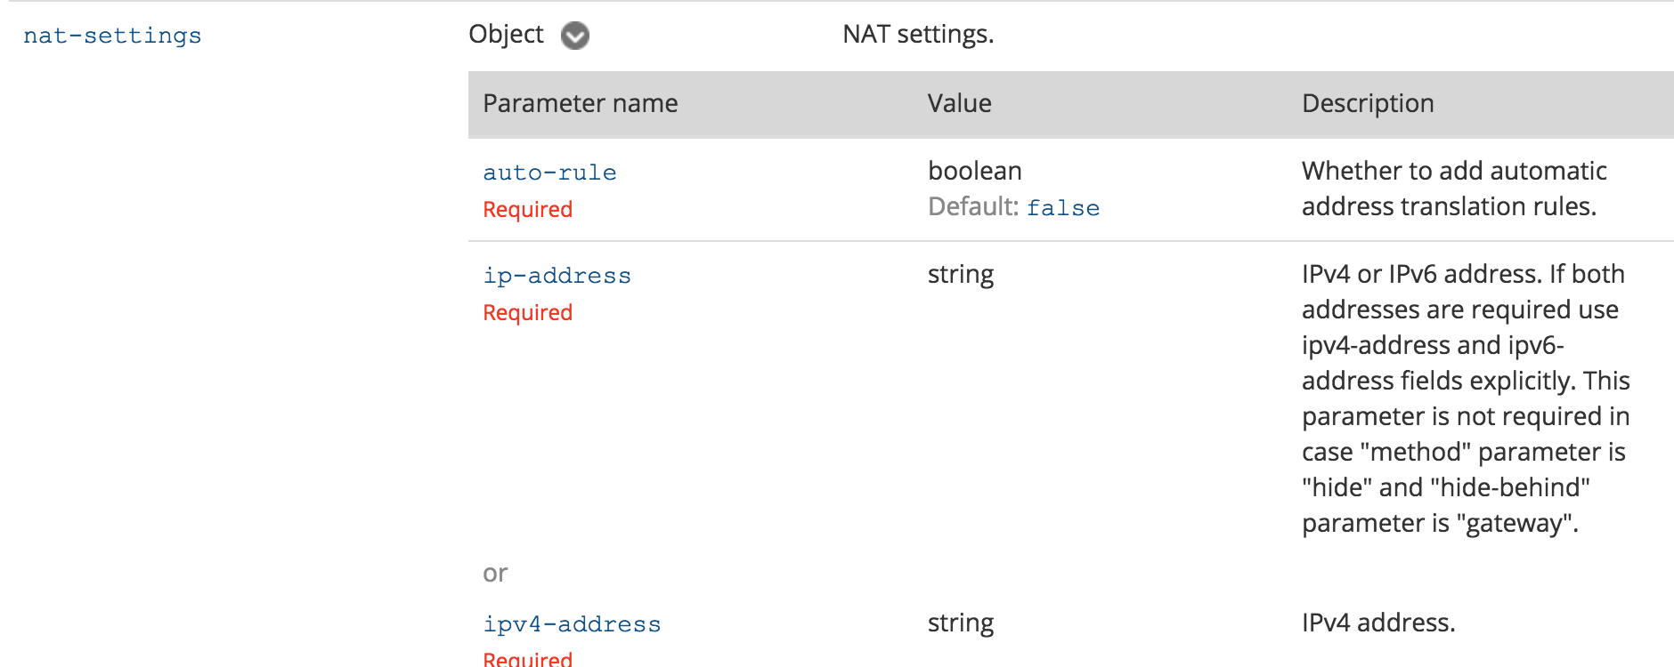
Bonus component: Sub-Key
add host name "New Host 3" ip-address "192.0.2.162" nat-settings.auto-rule true nat-settings.method "hide" nat-settings.hide-behind "ip-address" nat-settings.ipv4-address "192.0.2.1"
Key Sub-Key value
(always come in pairs)

Slide 36
The components: Switches
Login and create a new host
mgmt_cli login user api_user password vpn123 > id.txt
mgmt_cli add host name minion1 ip-address 11.11.11.11 –s id.txt
mgmt_cli publish –s id.txt
mgmt_cli logout –s id.txt
mgmt_cli switches (they are not arguments of the command)

Slide 37
One more important note…
Unlike dbedit, mgmt_cli does not prompt for management IP - It defaults to 127.0.0.1
To direct it to a remote IP, use either:
[--management, -m] Management server IP address / hostname (SMS Only)
[--domain, -d] Domain server IP address / hostname (MDS or SMS)
Environment variable: MGMT_CLI_MANAGEMENT
C:> mgmt_cli login -u api_user -p vpn123
Couldn't connect to server
C:>mgmt_cli login -u api_user -p vpn123 -m 10.0.0.49
sid: "Tn3eXnB1_DlLbk9MvIlEY3Hc3SGwUigt4DpC94-DIg8"
url: "https://hollywood-sm01:443/web_api"
uid: "74b817ed-f561-43a6-890c-d43bfd256822"
session-timeout: 600
last-login-was-at:
posix: 1455259540267
iso-8601: "2016-02-12T08:45+0200"
login-message:
header: "Warning - MiniMe takes security seriously"
message: "Authorized access only. Violators will be fed to sharks"

Slide 38
But wait… There’s more! Working in batch mode
Build a CSV. The columns will be the keys, with rows as values…
Execute against it
There is no 3. That’s it!
# cat minions.csv
name,ip-address,color
minion1,1.1.1.1,yellow
minion2,1.1.1.2,yellow
minion3,1.1.1.3,yellow
minion4,1.1.1.4,yellow
minion5,1.1.1.5,yellow
minion6,1.1.1.6,yellow
# mgmt_cli add host --batch minions.csv

Slide 39
Tips from My use cases

Slide 40
Order of Operations
Groups
Hosts
Networks
Rules
Etc…

Slide 41
Limits & Offsets (show commands)
Limits
Default: 50
Max: 500
Offset

Slide 42
It’s all in the details-level (show commands)
details-level
UID
Standard
Full

Slide 43
Hidden Command for Time Out
Default Query Timeout is 3 min
Can adjust using --conn-timeout

Slide 44
Some pre-built scripts in 80.x
$MDS_FWDIR/scripts/
web_api_show_package.sh -k <PACKAGE NAME> -d <DOMAIN NAME>

Slide 45
Useful Commands
Show changes
Show unused-objects
Where-used
Run-script

Slide 46
My Personal Thoughts
Start Simple
Create a Playbook
Talk to the CheckMates

Slide 47
Let’s Lab Some Stuff!
Make a ”Host” object
Create a ”Group” object and add your new ”Host” to it
Create a “Network” object and enable ”Auto NAT Hide Behind Gateway”
Create a “BATCH” import using CSV of at least 10 ”Host” objects
Add them all to the group you made in # 2
Delete it all

Slide 48
Interactive SHELL Scripting

Slide 49
Making Interactive Scrips
Printf or Echo
Printf “Hello World!\n”
Echo -e “Hello World!\n”
READ
Used to turn input into variables
Variables can be called in shell scrips using $ preceding the variable name.
Put it all together!
printf “What is the host name?\n”
Read HOSTNAME
Mgmt_cli –r true add host name “$HOSTNAME” ip-address “192.168.100.100”
Notes:
printf "This script will search a specific policy package for rules with a ZERO hit count.\nUse with caution for deleting rules..\nIf for any reason you make a typo and need to exit use CTRL+C.\nPress ENTER to continue”
read ANYKEY
echo Listing Access Policy Package Names.
mgmt_cli -r true show access-layers --format json | jq --raw-output '."access-layers"[] | (.name)’
echo What is the Policy Package Name?
read POL_NAME
mgmt_cli -r true show access-rulebase name "$POL_NAME" details-level "standard" use-object-dictionary true show-hits true --format json

Slide 50
Seq loop
for I in $(seq 1 10)
do
mgmt_cli -r true add host name Host-$I ip-address 192.168.100.$I
done

Slide 51
Remember the Limit and Offset??
for I in $(seq 0 500 9000)
do
mgmt_cli -r true show gateways-and-servers details-level full offset $I limit 500 >> list.txt
done

Slide 52
Extra Tools

Slide 53
SED/AWK
Used to transform and parse text
sed 's/regexp/replacement/g' inputFileName > outputFileName
^ - matches the beginning of the line
$ - matches end of the line
Fully support regex
sed "s/^/mgmt_cli -r true -d $DOMAIN/" $POL2-tmp2.txt > $POL2-delete-unused.txt

Slide 54
Let’s do Shell Scripting Labs!
Create an Interactive script that will ask for the ”NAME” and “IP-Address” of a host object.
Create a Script to make 50 HOST objects using a loop
Remember your flow… doing this without a session will take some time
Create a Script that uses a loop to create 50 Host objects and the name uses a input variable from a echo/read command.
Remember your flow… doing this without a session will take some time
Delete it all!
Tips!
chmod +x script_name.sh
./script_name.sh

Slide 55
JSON and JQ

Slide 56


Slide 57

JSON – JavaScript Object Notation
Lightweight data interchange format
Created in 1999
“Easy” to read/write
Easy to parse
JSON is text only

Slide 58
How to Read JSON – A Crash Course
Number: a signed decimal number that may contain a fractional part and may use exponential E notation, but cannot include non-numbers such as NaN.
String: a sequence of zero or more Unicode characters. Strings are delimited with double-quotation marks
Boolean: either of the values true or false
Array: an ordered list of zero or more values, each of which may be of any type. Arrays use square bracket notation and elements are comma-separated.
Object: an unordered collection of name–value pairs where the names (also called keys) are strings.
null: An empty value, using the word null

Slide 59
How to Read JSON – A Crash Course
{
"firstName": "John",
"lastName": "Smith",
"isAlive": true,
"age": 27,
"address": {
"streetAddress": "21 2nd Street",
"city": "New York",
"state": "NY",
"postalCode": "10021-3100”
},
"phoneNumbers": [
{
"type": "home",
"number": "212 555-1234"
},
{
"type": "office",
"number": "646 555-4567",
}

Slide 60
JSON and 80.10
JSON can be used as an output to mgmt_cli or SmartConsole CLI commands
Provide the flag “--format json” to the command
Output will be proper JSON format
Using the WebServices API all input is JSON formated

Slide 61
JSON – What now?!?
When used with a shell script we could use grep.
Could use sed/awk
What if we want multiple elements from the output?
What if we want to manipulate the text?

Slide 62
Enter ‘jq’
jq is a lightweight and flexible command-line JSON processor
jq is like sed for JSON data
jq can mangle the data format that you have into one that you want ☺
R80.X includes jq
Allows for easy data manipulation
Can be used to filter data when the R80 API does not allow

Slide 63
JQ – Example - Filtering
mgmt_cli -r true show unused-objects --format json | jq --raw-output '.objects[] | select(.type == ”group")'
{
"uid": "65846238-7556-45c7-989c-63a3750c704e",
"name": "group1",
"type": "group",
"domain": {
"uid": "41e821a0-3720-11e3-aa6e-0800200c9fde",
"name": "SMC User",
"domain-type": "domain"
}
}
{
"objects" : [ {
"uid" : "65846238-7556-45c7-989c-63a3750c704e",
"name" : "group1",
"type" : "group",
"domain" : {
"uid" : "41e821a0-3720-11e3-aa6e-0800200c9fde",
"name" : "SMC User",
"domain-type" : "domain"
}

Slide 64
Now Let’s Manipulate the Data
mgmt_cli -r true show unused-objects --format json | jq --raw-output '.objects[] | select(.type == ”group")
mgmt_cli -r true show unused-objects --format json | jq --raw-output '.objects[] | select(.type == ”group") | ("mgmt_cli -r true delete group name " + .name)' >delete-unused-hosts.txt
mgmt_cli -r true delete group name group1
mgmt_cli -r true delete group name group2
mgmt_cli -r true delete group name group3
mgmt_cli -r true delete group name New Group
mgmt_cli -r true delete group name New Group 5
{
"uid": "65846238-7556-45c7-989c-63a3750c704e",
"name": "group1",
"type": "group",
"domain": {
"uid": "41e821a0-3720-11e3-aa6e-0800200c9fde",
"name": "SMC User",
"domain-type": "domain"
}group}

Slide 65
JQ a place to start
JQ Play
https://jqplay.org/

Slide 66
Yup… I used it twice.

Slide 67
JQ - TIPS
Raw Output
-r or --raw-output
Formats into standard output instead of “ “ json output
| (that’s a pipe)
When to use “ or ‘ with a object
JQ Select Command
select(."installation-targets" == "all" |not)
select(.type=="simple-gateway")

Slide 68
JQ Tips – Cont’
Formatting Text using JQ
No spaces
Raw is very usefull
mgmt_cli -r true show hosts --format json | jq -r '.objects[] | ("My Name is " + .name + " My IP is " + ."ipv4-address")'
My Name is Host-5.5.5.5 My IP is 5.5.5.5
My Name is Host-5.5.5.7 My IP is 5.5.5.7
My Name is Host_127.0.0.1 My IP is 127.0.0.1

Slide 69
Oh wait! Remember that Limit & Offset??
total=$(mgmt_cli -r true -d show objects --format json |jq '.total')
I in $(seq 0 500 $total)
do
mgmt_cli -r true -d show hosts details-level full offset $I limit 500 --format json >> list.txt
done

Slide 70
JQ LABS
Simple Lab
Output a file that contains all your host objects Names and IP addresses. Add text
Advanced Lab
Create 10 ”NETWORK” Objects
Make 5 with AUTO Hide Nat Behind the Gateway Enabled
Make 5 with no NAT
HINT: Use your LOOPS from the last section to make this easy
Create a Script that will output the proper MGMT_CLI commands to delete the networks that have no AUTO NAT enabled.
HINT: Pay attention to the “Details-level” on your ‘show networks’ command
Use the API Guide
Use JQPLAY.org to filter your json
Notes:
mgmt_cli -r true show networks limit 50 offset 0 details-level "full" --format json |jq --raw-output '.objects[] | select(."nat-settings"."auto-rule"==true) | ("mgmt_cli -r true delete network name ") + (.name)'

Slide 71
Orchestration
&
Ansible

Slide 72
Ansible – What is it???
Ansible is a radically simple automation engine that automates many IT needs including the following
Cloud Provisioning
Configuration management
Application deployment
Intra-service orchestration
Commands are send to the end modules via SSH
Modules are available to make Ansible extensible
Many are included by default
Check Point’s module is not currently included by default

Slide 73
Ansible – What is it???
Ansible uses an inventory system
Simple Text Files (/etc/ansible/hosts)
Dynamic Inventory – think AWS, Azure, or OpenStack
Ansible Playbooks are used to orchestrate move/add/changes
Multiple tasks can be run in a Playbook
Playbooks can be combined
Ansible is driven by Python
Ansible playbooks are written in YAML

Slide 74
Ansible – YAML Ain’t Markup Language (YAML)
YAML - http://www.yaml.org/spec/1.2/spec.html
YAML and JSON aim to be human readable as a data interchange format
YAML can be easier for humans to read
YAML is similar to Python and indentation-based scoping is used
YAML has no direct correlation to XML

Slide 75
Ansible – Compare JSON to YAML – JSON First
{
"last-updated" : {
"posix" : 1515001214000,
"iso-8601" : "2018-01-03T17:40+0000"
},
"installed-version" : "635180014",
"installed-version-creation-time" : {
"posix" : 1514815200000,
"iso-8601" : "2018-01-01T14:00+0000"
},
"update-available" : true,
"latest-version" : "635180084",
"latest-version-creation-time" : {
"posix" : 1515067200000,
"iso-8601" : "2018-01-04T12:00+0000"
}
}

Slide 76
Ansible – Compare JSON to YAML – Now YAML
---
last-updated:
posix: 1515001214000
iso-8601: 2018-01-03T17:40+0000
installed-version: '635180014'
installed-version-creation-time:
posix: 1514815200000
iso-8601: 2018-01-01T14:00+0000
update-available: true
latest-version: '635180084'
latest-version-creation-time:
posix: 1515067200000
iso-8601: 2018-01-04T12:00+0000

Slide 77
Ansible – Using YAML
Don’t be a rookie and use tabs
Tabs are evil - use spaces for spacing in YAML files – quick example
---
- hosts: "192.168.1.1"
gather_facts: no
connection: local
tasks:
- name: "set shell"
raw: set user admin shell /bin/bash
- name: "save config"
raw: save config
- name: Waiting for 65 seconds to clear SSH session
pause:
seconds: 65

Slide 78
Ansible – Using YAML with variables
Ansible can include files that will be used as variables as part of the play
Variables are denoted by the double curly braces - {{ my_variable }}
When running a play a flag of --extra-vars can be added to the run to pass variables from the cli
Some variables can also come from an environment variable
Common uses are cloud credentials
Variables can also be included from the /etc/ansible/hosts
Review the /etc/ansible/hosts on your lab machines
Check for the [Gaia:vars] section

Slide 79
Ansible – Idempotence
Now to the important part –
The Check Point Ansible module does not support Idempotence…………….
What does that mean to us????
Be careful when you run a playbook
We must understand the state of the database and what we want to do
If an object already exists for example the playbook will fail since the module does not compare the existing state to the new state

Slide 80
Ansible – Check Point Module
Updated Ansible module can be found here
https://github.com/CheckPoint-APIs-Team/cpAnsible
Instructions on install are part of this GitHub site
Requires the Check Point API Python SDK

Slide 81
Always remember the flow
Login
Send Rest Action
Publish
Logout
https://<mgmt>/web_api/login
https://<mgmt>/web_api/add-host
https://<mgmt>/web_api/publish
https://<mgmt>/web_api/logout
Install Policy
https://<mgmt>/web_api/install_policy

Slide 82
Ansible – Simple Ansible Example - Login
---
- hosts: "localhost"
vars_files:
- vars.yml
- vars-vmware.yml
tasks:
- name: "login"
check_point_mgmt:
command: login
parameters:
username: "{{mgmt_user}}"
password: "{{mgmt_password}}"
management: "{{mgmt_server}}"
fingerprint: "{{mgmt_fingerprint}}"
register: login_response

Slide 83
Ansible – Simple Ansible Example – Do Something
- name: "Add Host"
check_point_mgmt:
command: add-host
parameters:
name: "CHKP-Hide"
ip-address: "{{ perimeter_gw_external_ip }}"
color: "red"
session-data: "{{login_response}}"

Slide 84
Ansible – Simple Ansible Example – Publish
- name: "publish"
check_point_mgmt:
command: publish
session-data: "{{login_response}}"

Slide 85
Ansible – Simple Ansible Example – Logout
- name: "logout"
check_point_mgmt:
command: logout
session-data: "{{login_response}}"

Slide 86
Ansible – Loops!
- name: "Create Hosts"
check_point_mgmt:
command: add-host
parameters:
name: "mytesthost_{{ item }}"
ipv4-address: "10.123.123.{{item}}"
color: blue
session-data: "{{login_response}}"
with_sequence: start=1 end=254

Slide 88
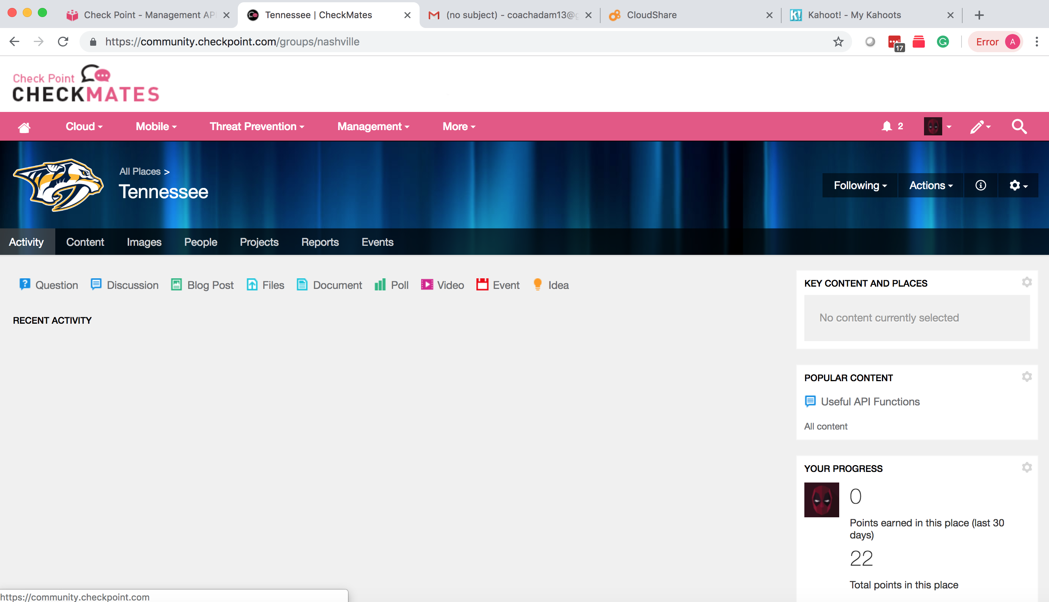

Slide 89
My GitHub
https://github.com/WadesWeaponShed/

Slide 90
THANK YOU

